Slide 1
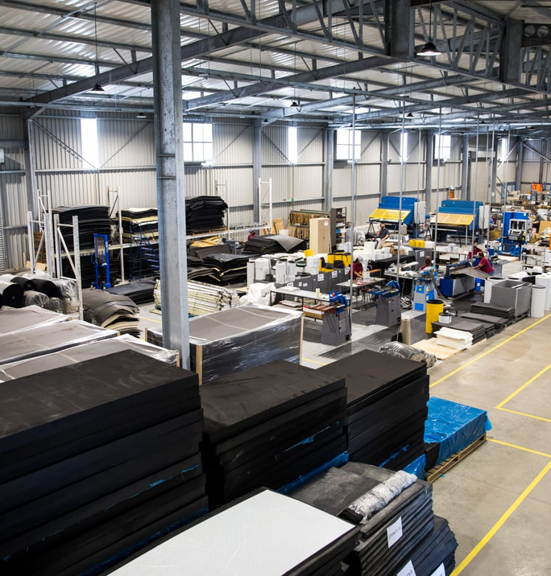
Co-operative Development Support Programme
Date: 23 June 2022

Slide 2
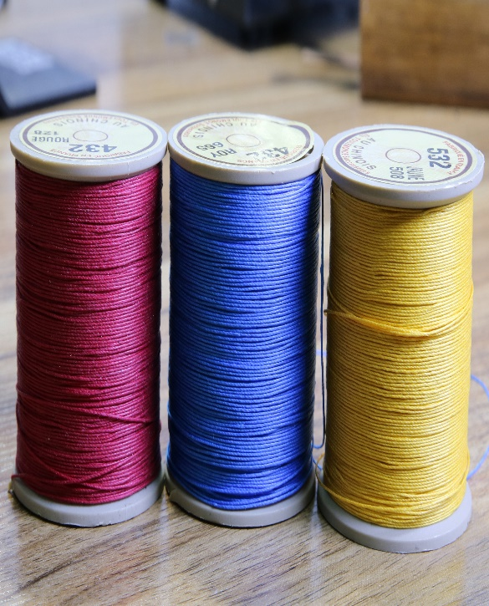
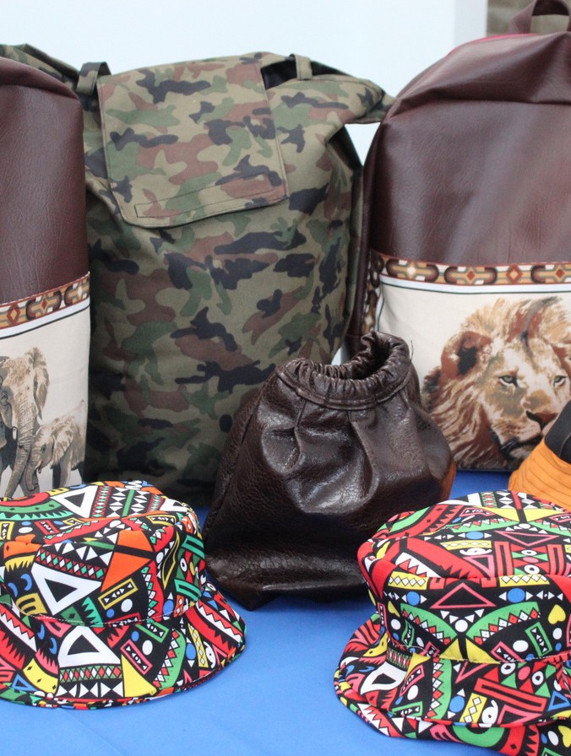
About the Department of Small Business Development

Slide 3
Who we are
The Ministry of Small Business Development was established in 2014 marking a turning point in history of SMMEs and Co-operatives development in South Africa, demonstrating Government’s commitment to place SMMEs and Co-operatives at the centre of economic growth and job creation.
The Department of Small Business Development (DSBD) was thereafter established as a standalone National Department in accordance with the reorganisation of some national departments announced by the President in May 2014.

Slide 4
DSBD Agencies
The two entities reporting to the Minister for Small Business Development are the Small Enterprise Finance Agency (sefa) and Small Enterprise Development Agency (Seda). The agencies report through governance arrangements that give them autonomy but also enable them to align their strategies with Government policy and priorities.
Non-Financial Support
Financial Support

Slide 10
Departmental Programmes

Slide 11
Co-operative Development Support Programme

Slide 12
CO- OPERATIVE DEVELOPMENT SUPPORT PROGRAMME (CDSP)
CDSP is a programme of the DSBD with an objective to support cooperative enterprises financially and non-financially.
The Co-operatives Act, No. 14 of 2005 and Co-operatives Amended Act, No. 6 of 2013, and Integrated Co-operatives Strategy provide the legal basis for the development of this programme.
In partnership with sefa, the CDSP programme offers blended financing to eligible co-operatives on cost-sharing funding of a combination of a grant and loan.
The grant funding portion is capped at 70% of the total approved funding while the loan portion is capped at 30% of the total approved funding
Total funding is limited to R2,500,000 towards qualifying activities as outlined
The grant support is available for machinery, equipment, infrastructure, commercial vehicles and business development support (BDS) necessary to grow co-operative enterprises to ensure that the co-operative enterprises develop to be more sustainable and competitive.

Slide 13
Eligible Enterprises

Slide 14
Eligible Enterprises
Primary Cooperatives
To be eligible for CDSP, a primary cooperative must satisfy all the mandatory requirements as set out below:
Be incorporated and registered in South Africa in terms of the Cooperatives Act, Act No. 14 of 2005( as amended);
Be a primary cooperative with a majority black membership;
Have business activities in any sector
Adhere to cooperative principles;
Be biased towards women, youth and people with disabilities;
Expected to furnish proof of training or experience of all members of a primary cooperative in the areas of cooperative governance, business management and technical training in fulfilment of the agreement entered with CDSP.

Slide 15
Eligible Enterprises
Cluster Cooperatives
To be eligible for CDSP, a primary cooperative must satisfy all the mandatory requirements as set out below:
Be a registered secondary cooperative in South Africa, registered in terms of the Cooperatives Act, Act No. 14 of 2005( as amended), or;
Be a secondary cooperative with majority black membership
Have business activities in any sector
Adhere to cooperative principles;
Be biased towards women, youth and people with disabilities;
Expected to furnish proof of training or experience of all members of a primary cooperative in the areas of cooperative governance, business management and technical training in fulfilment of the agreement entered with CDSP;
Primary cooperatives registered under the secondary cooperative must satisfy all the mandatory requirements

Slide 16
Qualifying Interventions

Slide 17
Qualifying Interventions
For blended finance
Machinery and equipment, tool,
Specialised tools
Operational costs
Commercial vehicles
Infrastructure requirements
Product or service development
Business Development Support
Market Development
Information and Communication technology linked to the cooperative development activities
The adjudication committee may consider for support, at its discretion, any other costs related to the activities applied for.

Slide 18
Qualifying Interventions
For feasibility studies
Operational costs that include, among others, project personnel, researcher etc.;
Specialist (technical, scientific, consultation and/or contracting personnel);
Running costs ad overheads (e.g printing and telephone) to a maximum of ten percent of the total budget;
Intellectual property rights(IPR). IPR for the project with project relevant provisions f the National Intellectual Property Management Office (NIPMO) an project relevant legislations as Copyright Act, 1978 (Act No. 98 of 1978), designs Act, 1993 (Act No195 of 1993) Intellectual Property Laws Amendment Act, 2013, and Intellectual Property Law Rationalisation Act, 1996 (Act No. 107 of 1996);
Costs of registration and litigation of patents
Costs for registration of patents

Slide 19
Application Procedure

Slide 20
Application Procedure
Who can apply?
The applicant must
Register on the SMMESA database: https://smmesa.gov.za/
Complete the simplified online application form available from
www.dsbd.gov.za/www.sefa.org.za/www.seda.og.za
Be an entity registered with CIPC (e.g Constitution, CR10);
Be 100%-owned by a South African;
Priority will be given to cooperatives owned by Women, Youth and Persons living with Disabilities
FICA documents (e.g Municipality accounts, lette from traditional authority);
Lease agreement or Permission to Occupy (P.T.O)
CVs and certified ID copies of Director/ founding members;

Slide 21
Application Procedure cont…
Three (3) months bank statements
Detailed business plan
Three (3) year cash flow projections;
Latest Annual financial Statement or Management Account not older than three (3) months from date of application in the case of expansion;
Relevant Industry certification – where applicable;
Details of loan facility;
Be willing to participate in the DSBD/ SEDA facilitated business development process;
Be in the township or peri urban or rural/ small towns
To prevent double dipping the applicant must submit a sworn affidavit regarding support received from the State in the five year period preceding the application

Slide 23
Vision & Mission
EXPECTED IMPACT:
Increased contribution of small enterprises to SA economy, economic growth, job creation and equity – National Small Business Act of 1996, as amended
VISION:
To be a centre of excellence for small enterprise development in South Africa
MISSION:
“To promote entrepreneurship and facilitate the development of small enterprises by providing customised business support services that result in business growth and sustainability in collaboration with other role players in the ecosystem.”

Slide 24
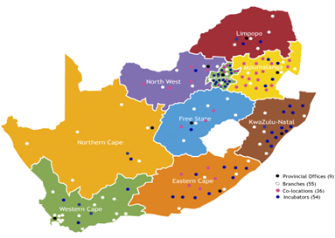
Enterprise Support Network
Business
Talk
Assess
Advise
Train
Register
Business
Start
Market Plan
Counselling
Finance
Support
Business
Build
Capacitate
Mentor
Procure
Franchising
Business
Grow
Growth Support
Export Readiness
Manuf. Support
Supplier Dev.
54 Seda
Branches
77 co-locations
(EDD)
101 Seda Technology and TVET Incubators
(STP)
Incubation for Start-Ups
Assessment, Selection
Training, Systems, Tools
Offices, Workshops
Shared Business Processes
Market & Finance Plans
Mentoring, Tracking

Slide 25
Seda Operations Model
Process Flow
Intervene/Support & Refer
(Service Providers; Consultants; other Seda divisions & Partners)
Asses & Diagnose (Tools & BA’s/RF’s)
Assess Improvement/Impact
Attract
Engage
Note: Seda Supports all Sectors and Industries while prioritising Key growth sectors in the Province. We support different types of Profit Orientated Legal Entities from Sole Proprietors and Private Companies to co-operatives and other Collectively Owned entities.

Slide 26
Client Journey on the Programme
Level 1
Talk
Level 2
Build
Level 3
Grow
Small Enterprise Coaching programme
Women Enterprise Coaching programme
Incentives schemes: (EMIA,SSAS, Manufacturing Support Scheme)
Access to Markets (e-commerce, trade fairs, B2B’s, B2C’s)
Domestic market
International market
Post-event mentorship
Technical training (QMS & certification, HACCP, Quality & Standards
Innovation Support
Export Readiness programme (Interventions based on ERAT)
Export Mentorship
Manufacturing Support programme
Supplier Development programme
Incentive Scheme (Co-operative Incentive Scheme, Blended finance and any other financial instrument)
Registration of client
Advice
Assessments (ACO,CPE, ERAT,SBAT, EDT)
Capacity building Trainings (Basic Business Skills, Start up-1)
Business Development Services
Start
Mentorship & Coaching
Information sessions
Notes:
Point 2: mentorship. Launching the programme next year…implementation of the programme starts after the launch. Will be in touch with specific offerings and the processes and time frames. Breakdown each objective with explanation.

