Slide 1
WEBINAR ON
THE ROLE AND CONTRIBUTION OF COOPERATIVES TOWARDS THE SOUTH AFRICAN ECONOMIC RECONSTRUCTION AND RECOVERY PLAN
22 JUNE 2022

Slide 2
PRESENTATION OUTLINE
Background and context
Role of DSD in cooperatives development
DSD support to cooperatives
Rationale for supporting cooperatives
DSD food & nutrition security interventions to support poor and vulnerable groups
The Household Food & Nutrition Security Programme (HF&NSP) support for cooperatives
Concluding remarks

Slide 3
BACKGROUND AND CONTEXT
The minister for social development performance agreement for the period of June 2019 to April 2024:
Priority 4: Consolidating the social wage through reliable and quality basic services
Target: Create a harmonised social protection system to ensure that the state is able to cushion citizens from various forms of vulnerability and dehumanising poverty.
Outcome | A comprehensive, inclusive and responsive social protection system to build the resilience of citizens
Interventions | Indicators | Baseline | Targets | Minister’s responsibility
Sustainable community development intervention/foster vibrant and sustainable communities | food and nutrition security initiatives for vulnerable individuals and households towards a goal of ending hunger implemented | 2.4 million individuals provided with nutritious food | 9 provincial wide food and nutrition security initiative for vulnerable individuals and households implemented by 2024 | Ensure the proper functioning and resourcing of the Community Nutrition and Development initiatives, and that centres and provincial food depots work
Create vibrant and sustainable communities | % of households profiled, empowered through SL programmes | N/A | 10% of profiled households accessing Sustainable Livelihoods (SL) initiatives | Support the development of this strategy and the buy in by other government Department for empowering vulnerable and poor households especially women and youth.
 | % of social protection beneficiaries linked to SL opportunities | N/A | 0.5% of social protection beneficiaries linked to SL opportunities

Slide 4
Role of DSD in Cooperatives Development
The essential role of Co-operatives in the South African economy and globally cannot be ignored, Co-operatives have been identified as a positive social and economic dynamic force to build vibrant and empowered communities while facilitating stable economic growth
DSD has strategic intent to develop and implement poverty eradication programmes, social -protection and social development amongst the disadvantaged.
The support to cooperatives is a strategic focus of the Department’s goal to alleviate poverty, reduce inequality and unemployment.
DSD is dedicated to setting aside a sustainable portion of its goods and services requirements for co-operatives.
The role and strength/ capabilities of Co-operatives is the identification and linkages to economic opportunities)
Empower communities to actively participate in the total value chain of productive means of generating income and promote sustainable livelihoods.

Slide 5
Role of DSD in Cooperatives Development
A Co-operative is a group of people acting together to meet the common needs and aspirations of its members, sharing ownership and making decisions democratically.
Characteristics of Cooperatives (not limited)
Co-operatives have a potential in alleviating poverty while promoting mutual understanding and education among their members and involving communities at large.
Co-operatives are also regarded as systems of enterprise that escalate the trading power of members through member economic participation.
Co-operatives have the potential to create short, medium to long-term jobs in disadvantaged and vulnerable societies

Slide 6
DSD SUPPORT TO COOPERATIVES
DSD, its agencies and the programmes implemented is seeking:
To facilitate and coordinate linkages of cooperatives to economic opportunities and ensure access to 30% of government procurement by cooperatives as pronounced in relation to the implementation of the Preferential Procurement Act.
To facilitate social mobilization programs on the on the role and strength of cooperatives for economic development and building vibrant and empowered communities.
To facilitate linkage of Social Protection Beneficiaries to economic opportunities through cooperatives.
To facilitate the establishment of cooperatives as an alternative business for job creation and community development.
To Link cooperatives to economic opportunities created through DSD programmes.

Slide 7
Rationale for Supporting Cooperatives
Community participation and empowerment: cooperatives have the potential to mobilise and develop the entire community and encourage a culture of saving together as a group.
Cooperatives can benefit and support livelihoods for communities. We view them as an easier mode of entry into the economic participation, aggregation of produce and participation in the market.
Member participation and motivation: The active participation of members in the management of a co-operative is likely to reduce costs and thus enhance effective use of limited resources.
Cooperatives have the potential to create short, medium to long-term jobs in poor and vulnerable societies.
Economically empowering women and youth through the active promotion of cooperatives; is a win-win that can benefit not only women, but society at large .
Cooperatives have the potential to reduce the impact of patriarchy on women and cultural deprivation.

Slide 8
DSD FOOD & NUTRITION SECURITY INTERVENTIONS TO SUPPORT POOR AND VULNERABLE GROUPS
DSD FOOD & NUTRITION SECURITY INTERVENTIONS
Cash Transfers/ social grants
SRD/ R350 Covid Grant & Food Vouchers
Older persons’ Luncheon Clubs
Community Nutrition Development Centres (CNDC)
ECDs ( children 0-4yrs)
Drop in Centres /Home Community Based Care
(HCBC)
Child and Youth Care Centres (CYCCs)

Slide 9
THE HOUSEHOLD FOOD & NUTRITION SECURITY PROGRAMME (HF&NSP) SUPPORT FOR COOPERATIVES
Provision of logistical support to ensure procurement of produce from community food producers.
Facilitate skills training and empowerment of communities in partnership with technical partners and other relevant sector Dept’s (DoRD & DAFF ect).
Procurement of produce/ create access to markets local food producers.

Slide 10
Critical Components:
Inter-sectoral coordination on the food value chain
Public food procurement – NSNP, CBFPs = Bulk procurement of food
Strategic food sourcing in PFDCs = Cost effectiveness.
Sourcing of food from local producers - Coops & SMMEs = LED.
Provision of nutritious food to PVMs in CNDCs.
PIAs coordination & monitoring of nutrition support services by CNDCs.
THE HF&NSP MODEL
Donated food
Bulk procurement
Provincial Food Distribution Centre (9)
Local food producers
Local food producers
District Distribution Centre
District Distribution Centre
District Distribution Centre
District Distribution Centre
District Distribution Centre
CNDCs
Cooked meals
Households
Food parcels
Food Agencies:
Feeding organisations

Slide 11
COMMUNITY NUTRITION DEVELOPMENT CENTRE (CNDC)
Community facility: Hall/Church operated by CBOs
Cooked Meals = 5 X per week
3 Cooks & 1 CNDC Coordinator
250 or more Individuals/ CNDC
Source local produce: fresh vegetables & fruits
CNDC equipment – Tables & chairs, gas stove, etc..
Cutlery & crockery supply for CNDC
Cooks Training & uniforms
PARTNERSHIPS:
NPOS
IDT – CWP & EPWP
Private sector
Opportunities:
Training & skills development
Nutrition education
Community development programmes
PRODUCER COOPS
Agric Development & Asset Building
Enterprise Development
Skills Development and capacity Building
Social Protection
Employment creation
Local Produce
Local Produce
Local Produce

Slide 12
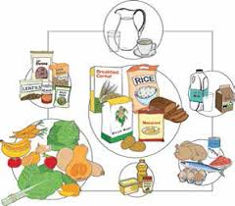
CNDCs Menu inline with Food-based dietary guidelines
DAYS | LUNCH MEAL PLAN | FOOD ITEM | SERVING PORTION SIZE
1 Monday | Protein | Chicken Stew | 120g
 | Starch | Maize Pap | 90g
 | Vegetable/fruit | Green & yellow Vege in season | 120g
2 Tuesday | Protein | Mince | 120g
 | Starch | Maize Pap | 90g
 | Vegetable/fruit | Whole Fruit | Medium size
3 Wednesday | Protein | Beef Stew | 120g
 | Starch | Boiled Rice | 60g
 | Vegetable/fruit | Yellow & Green Vege | 120g
4 Thursday | Protein | Cooked Beans | 100g
 | Starch | Cooked Samp | 80g
 | Vegetable/fruit | Yellow & Green Vege | 120g
5 Friday | Protein | Pilchard Stew | 120g
 | Starch | Sweet Potato/Rice | 90g
 | Vegetable/fruit | Yellow & Green Vege | 120g

Slide 13
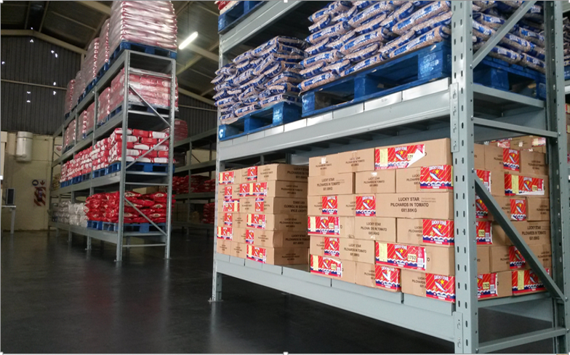
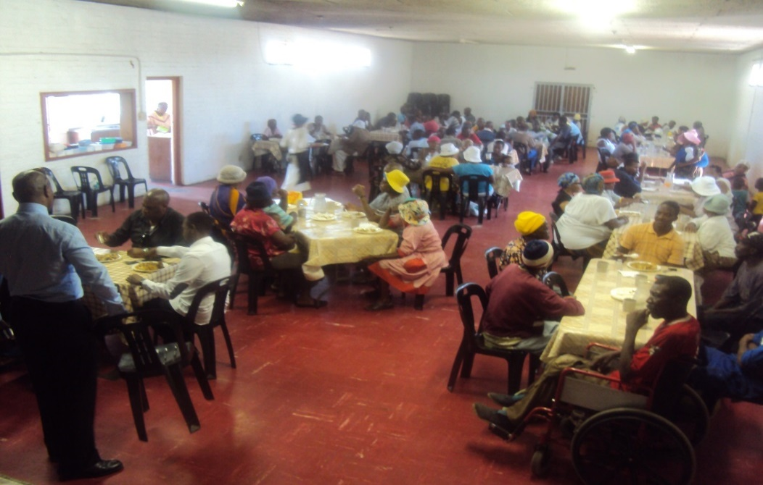
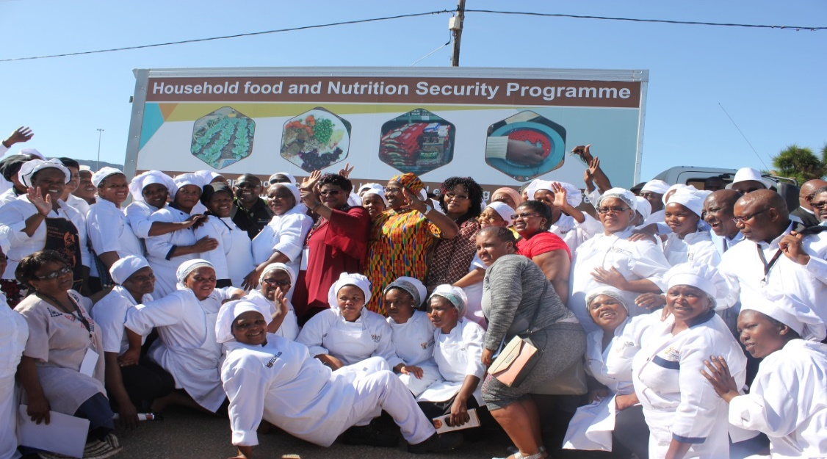
Programme overview Pictogram
Vehicles deliver food to CNDCs
PFDC warehouses & bulk food procurement
Cooks trained & uniformed to prepare food
PVMs served nutritious food/meals

Slide 14
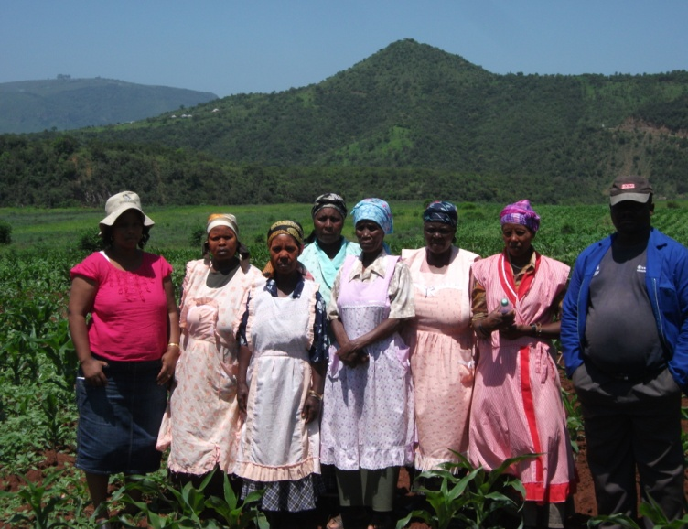
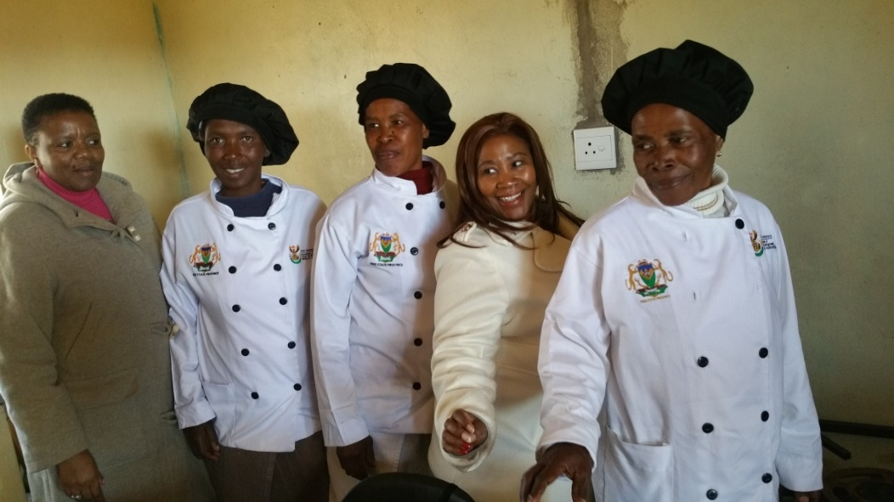
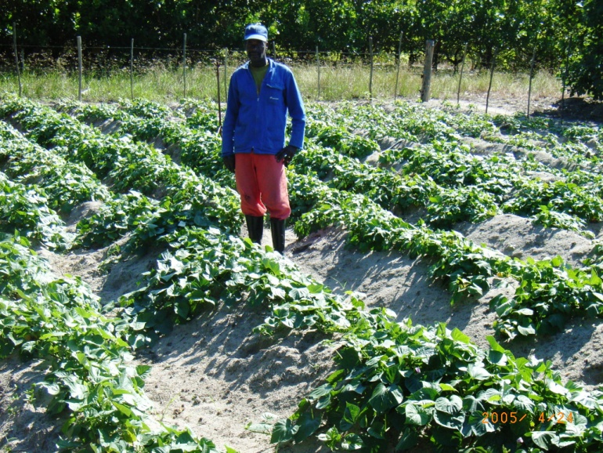
Integration: Food production; Sourcing from Local Producers & Cooperatives ; Nutrition & Sustainable Livelihoods
LED
Local coops
Nutritious Food provision
Food production & Dev’t opportunities
Food procurement

Slide 15
CONCLUDING REMARKS
DSD is seeking to strengthen local sourcing of good and services through public procurement to benefit local suppliers including cooperatives;
Thereby create sustainable livelihoods, strengthen Local Economic Development, alleviate hunger; and poverty, development of communities beyond the social protection mandate.
There is however a lot of work to build cooperatives model and understanding to avert the high rate of failure of cooperatives due to improper formation.

