Slide 1
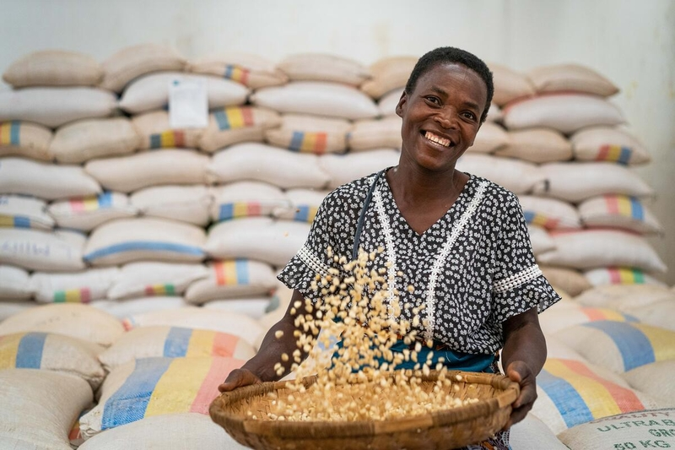

SUPPORTING SMALLHOLDER FARMERS THROUGH FOOD SYSTEMS TRANSFORMATION
NDA DIALOGUE - 22 June 2022

Slide 2
AGENDA
1
3
WHY ARE FOOD SYSTEM INEFFIENCIES IMPORTANT?
SUPPORTING SMALLHOLDER FARMERS THROUGH 4 IMPACT PATHWAYS
3.1
IMPACT PATHWAY 1: CREATING STABLE DEMAND
2
FOOD SYSTEM IMPACTS ON SMALLHOLDER MARKET ACCES
3.2
IMPACT PATHWAY 2: INCLUSIVE AGGREGATION
3.3
IMPACT PATHWAY 3: HOUSEHOLD LEVEL SUPPORT
3.4
IMPACT PATHWAY 4: CONDUCIVE ENABLING ENVIRONMENT

Slide 3
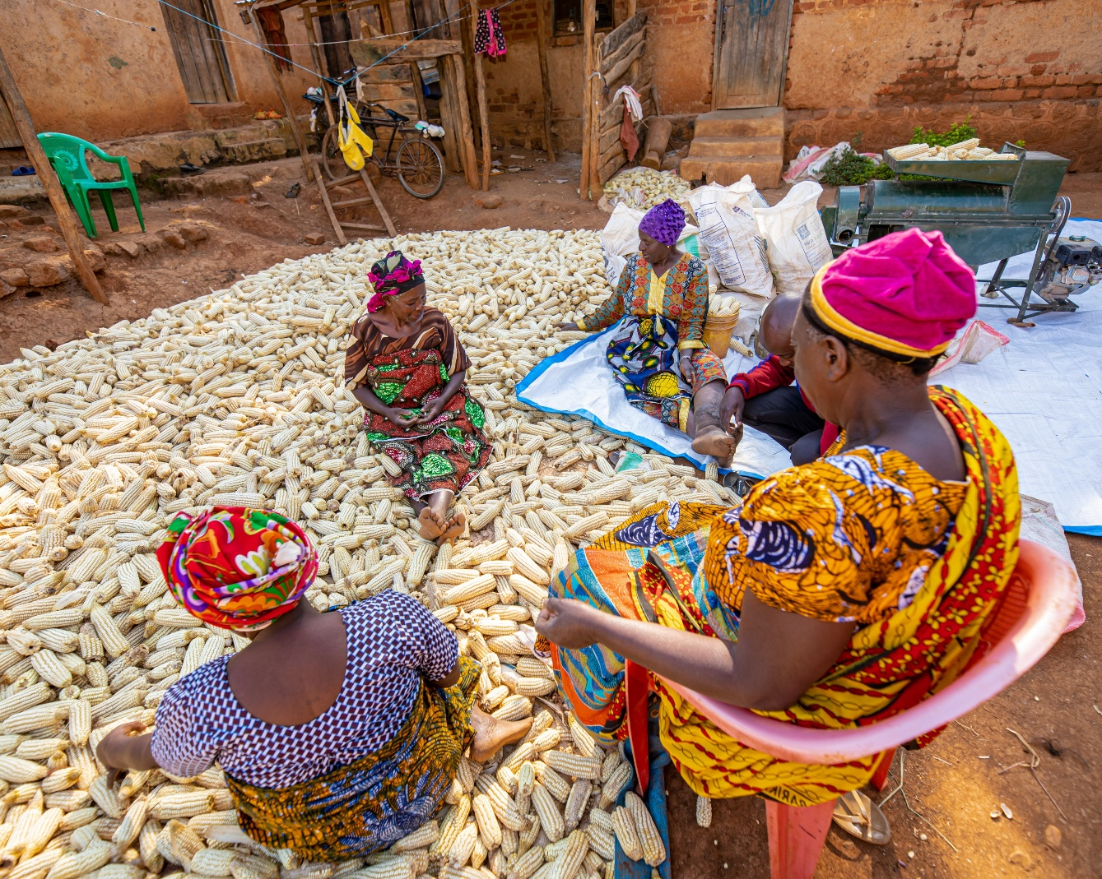
1. WHY ARE FOOD
SYSTEMS INEFFICIENCIES
IMPORTANT?
Inefficient food systems contribute to food shortages, high prices of nutritious foods, limited diversity of food production and food insecurity at the household level. This impacts vulnerable groups which as a result of these challenges have limited access to affordable and nutritious diets and which ultimately affects human capital and development outcomes.

Slide 4



2. FOOD SYSTEM IMPACTS ON SMALLHOLDER MARKET ACCESS
MARKET INFRASTRUCTURE
MARKET ACCESSIBILITY
LIMITED DIVERSIFICATION & CROP SPECIALISATION
CONSUMPTION & DEMAND PATTERNS
ROADS & TRANSPORTATION NETWORK
POST HARVEST LOSS & LACK OF STORAGE
AGRICULTURAL INVESTMENT, INPUTS & ACCESS TO FINANCE
STAGNATING PRODUCTION
Notes:
Rural areas are extremely poor, a condition which fosters inadequate infrastructure construction and maintenance particularly within the distribution system. In turn, poverty in these areas is increased by the isolation caused by lack of infrastructure, resulting in a ‘low-level equilibrium trap’.
Poor access to markets is mirrored by poor access to all kinds of rural services and it is felt more acutely in rural areas due to lack of sustainable strategies to
improve market access. As a result farmers in remote areas are always poorly served by agricultural traders and are often obliged to accept seemingly unattractive prices for their produce.
Even with full access to markets, many people cannot buy food because they cannot afford the costs. Consumers cannot purchase enough food to feed themselves and their families due to the lack of purchasing power and low incomes. Many farmers fail to generate an adequate return on their crops due to limited access, post harvest loss and knowledge of market opportunities, meaning they are unable to earn a sustainable income to pay off their investments

Slide 5
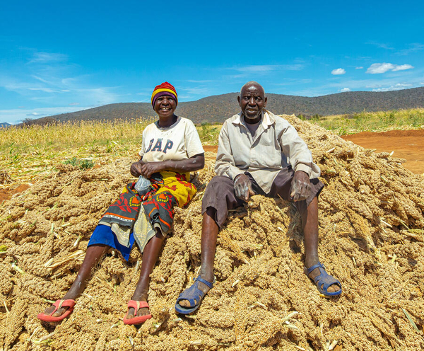
3. SUPPORTING SMALLHOLDERS THROUGH 4 IMPACT PATHWAYS
Creating stable demand (buyers)
Inclusive aggregation systems (aggregators)
Conducive enabling environment (market system)
Household-level support (farmers)
Notes:
WFP works with the government across the region, private sector, and development partners to strengthen the livelihoods and formal market opportunities of smallholder farmers. Through Smallholder Agriculture Market Support (SAMS), WFP addresses the constraints faced by smallholder farmers (SHF) such as postharvest losses, financial management and market access. The initiatives provide them with market information, facilitates training on cooperative governance and agribusiness, and creates market access amongst other areas.
1. Creating stable demand (buyers): Creating stable demand from WFP and other quality-oriented buyers, other institutional buyers and private companies encourages smallholder farmers to invest in agriculture.
2. Inclusive aggregation systems (aggregators): Strengthening inclusive aggregation systems such as farmer organizations (FOs) and cooperatives that empowers farmers to work together to build collective businesses, increasing their bargaining power and access quality-oriented markets.
3. Household-level support (farmers): Support at the household level helps farmers produce more high-quality crops, reduce post-harvest losses, improve gender equality, and strengthens household nutrition.
4. Conducive enabling environment (market system): Investments in strengthening market systems for smallholder farmers and the government’s food based programmes can potentially create a vibrant and inclusive agricultural trade in rural areas.

Slide 6

3.1 CREATING STABLE DEMAND
WFP supports farmer organisations and smallholder farmers by connecting them with markets. Home grown school feeding is one example of sustainable markets that impact cooperatives and smallholder livelihoods while supporting food security and human capital investment.
In Malawi farmer organisations and cooperatives are identified through the Ministry of Agriculture at National and District levels, trained and linked to schools to supply diversified, locally produced food commodities for Home Grown School Feeding.
Farmer organisations provide schools with commodities year round through a competitive process.
School feeding activities are then integrated with WFP’s livelihood interventions to enhance production and productivity capacities.
Notes:
HGSF provides a long-term and reliable market intentionally designed via the schools as opportunities to link SHF to markets and enable them to participate in broader food system.
The demand for diversified meals and the promotion of healthy diets by schools creates demand for production, processing, supply and consumption of diversified food commodities stimulating SHF production to respond to these needs and ensure adequate supply to school all year round. In addition, it can promote animal husbandry (small animals – chicken pigeons, bees, etc) for strengthened community livelihoods.

Slide 7
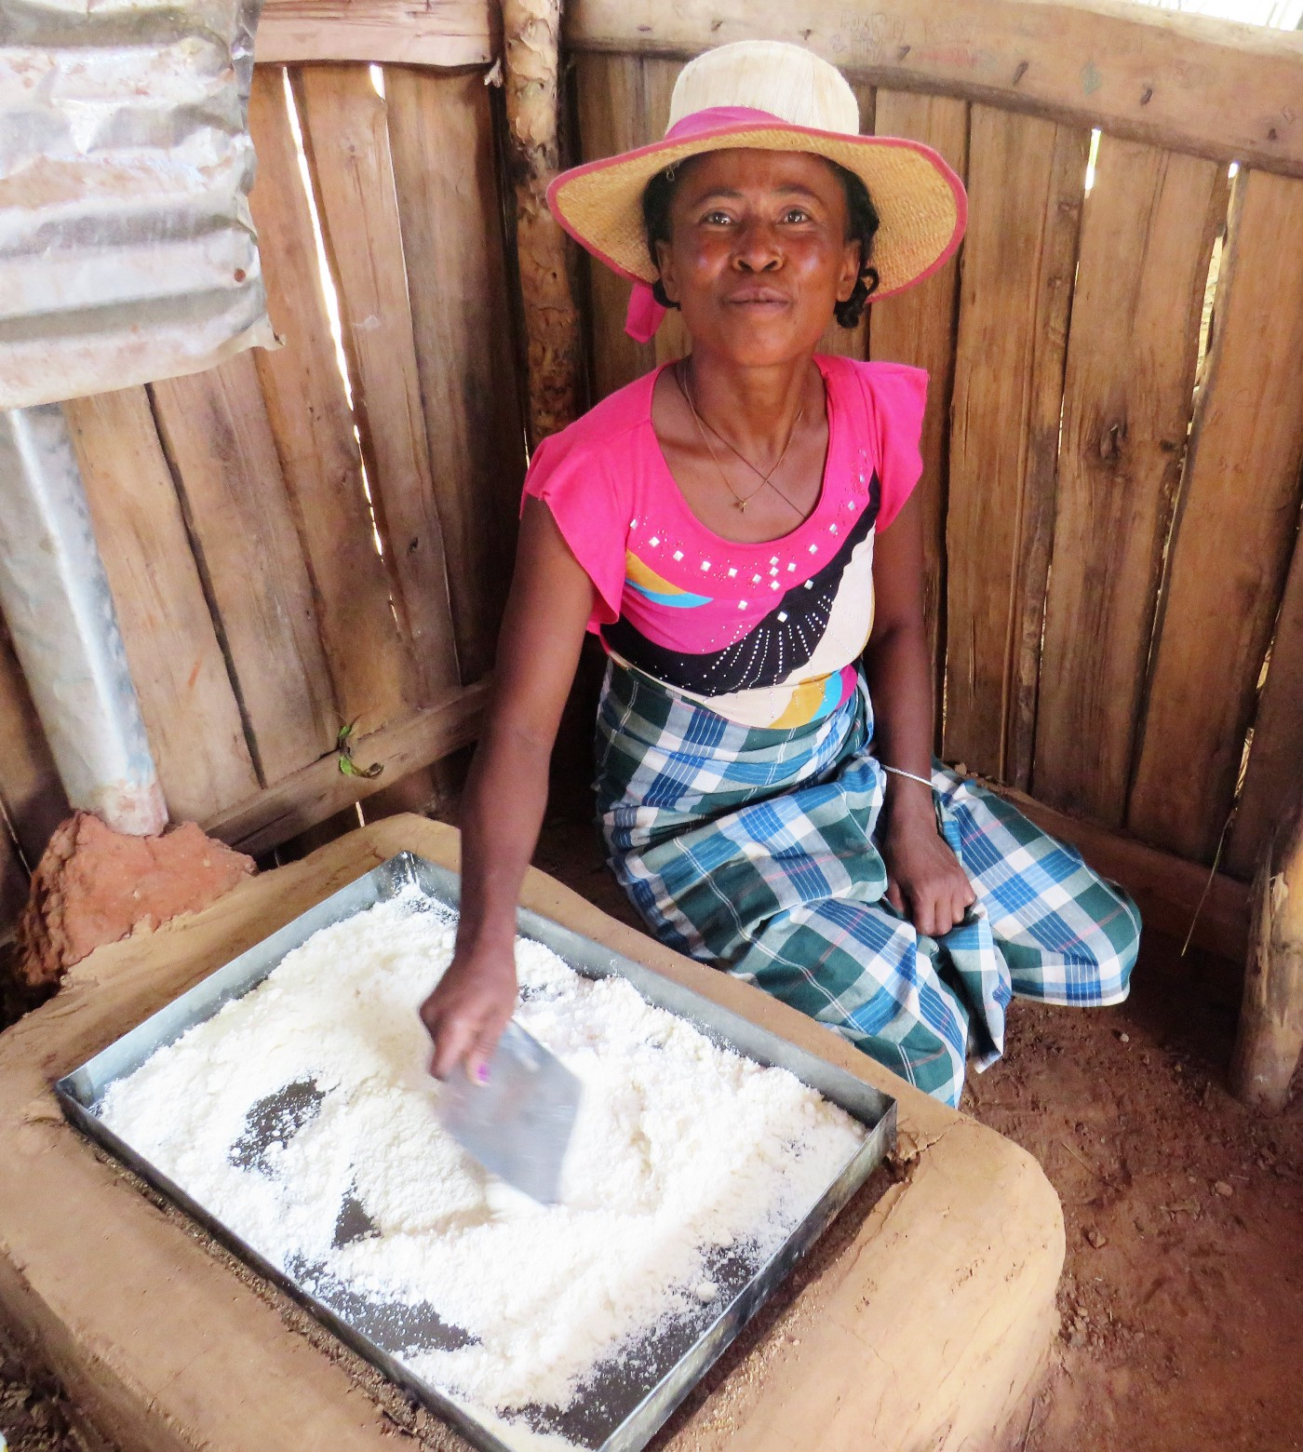
3.1 CREATING STABLE DEMAND
In Madagascar producers benefiting from WFP’s food assistance are empowered to create and work collectively in organizations.
These organizations are then provided with the necessary equipment and capacity strengthening trainings. WFP develops the technical capacities of farmers’ organizations to improve the quality, storage and handling of food products, and increases their market access by linking them to the Home Grown School Meals programme as well as other initiatives, including those led by the government.
WFP also increases household nutrition through nutrition education and encouraging community-based cassava fortification and processing of cassava into Gari .
Notes:
Usually local communities consume boiled or fried cassava, or dry the tuber along with the skin for later use. Drying cassava affects both its quality and taste, and above all, is the number one cause of waste. When cassava is processed into gari, a form of flour or flakes, its shelf life is extended, it can be used in a variety of recipes, and fortified during transformation. This also contributes to food diversification.In southern Madagascar, gari offers communities an affordable and adequate food option, particularly during the lean season. The transformation process allows producers to gain better incomes as gari fetches higher prices on local markets. The introduction of improved processing technologies, techniques and practices also reduce post-harvest losses by 30 percent.
Products consumed in schools will stimulate widespread market demand and therefore if properly processed could easily penetrate the market. Many of the types of products suitable for small-scale productions can obtain a higher value in the market if processed. Fruits and vegetables may fetch a higher price and expand profit margins for producers when they can be processed into a range of dried foods, jams, juice and pickles.

Slide 8
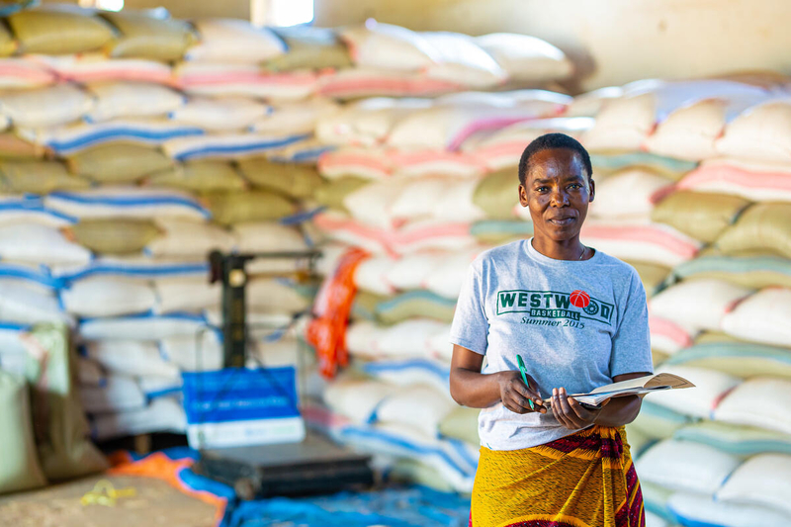
3.2 INCLUSIVE AGGREGATION SYSTEMS
WFP focuses on strengthening governance and business management of Farmer organisations (FOs) for better access to markets
WFP supports cooperatives with a package of business development support for strengthening the governance, supply and incomes of cooperatives and aggregators to meet quality and safety standards of national buyers and potential premium ones for regional and global market.
Notes:
In Zambia WFP is establishing aggregation systems, that link smallholder to warehouse receipt systems and support the development of improved market infrastructure and storage at community level.

Slide 9
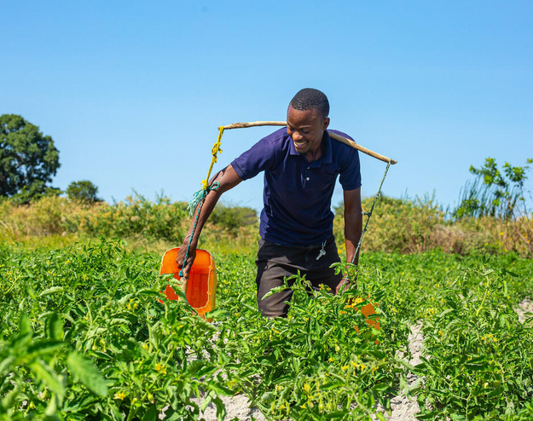
3.3. HOUSEHOLD LEVEL SUPPORT
-Supporting production
WFP supports farmers and farmer organisations in the promotion the use of conservation agriculture practices that increase yields and scale up the use of drought-tolerant and indigenous crops.
In Zambia WFP continues to support the government in enhancing agricultural productivity by facilitating access to affordable financial services, such as traditional micro-financing and village savings, input credit for nutrient dense value chains, and weather index insurance.
Notes:
Increasing production : promote the use of conservation agriculture practices that increase yields and scale up the use of drought-tolerant and indigenous crops.
In Malawi through its integrated resilience approach WFP supports entrepreneurship, innovation and access to inclusive finance by “scaling-up” existing Village Saving Loan Groups (VSLAs) which have interest and potential to start-up micro and small-scale business for better nutrition.

Slide 10
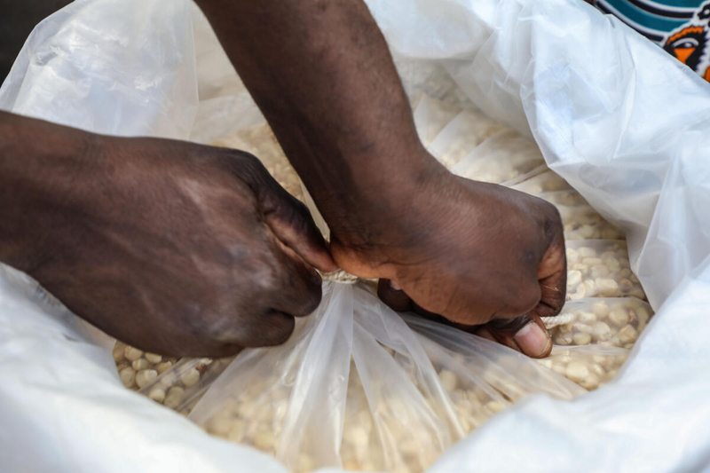
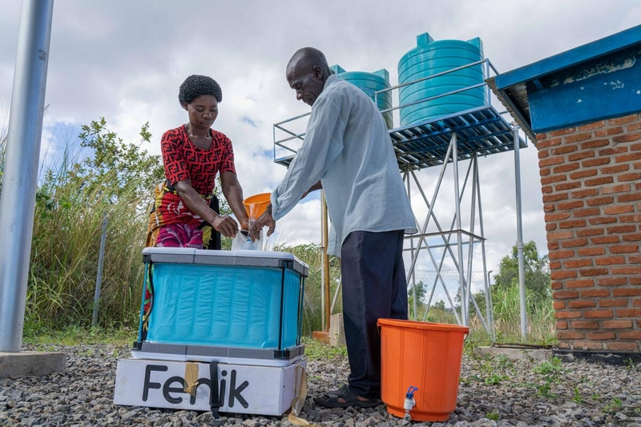
3.3. HOUSEHOLD LEVEL SUPPORT
- Reducing loss
WFP trains smallholder farmers through farmer organisations on how to use improved post-harvest handling methods, combined with simple but effective hermetic storage equipment.
WFP supports farmers across the region with hermetic storage equipment - which is both air and water tight, helping to guard against insects, rodents, mould, and moisture. To guarantee supplies of technologies at community level, WFP facilitates linkages between agro-dealers and manufacturers of technologies while supporting demand creation activities to raise awareness on the technologies.
Notes:
Post-harvest losses have significant nutritional, health, and financial impacts for both consumers and farmers, disproportionately affecting women, who are largely responsible for managing post-harvest drying, cleaning, and storage. For rural families, many of whom already live on the edge of hunger, lost food means lost land, water, fertilizer and income for those who can least afford it. Lost food also deprives farmers of the opportunity to grow and strengthen their businesses.
In some developing countries, smallholder farmers regularly lose 40 percent of their harvest due to inadequate storage. Consequently, many farmers sell their produce immediately after harvest—at a time when prices are low due to high supply – only to buy back the same produce later at increased prices.
In Malawi The Fenik cooler uses sophisticated engineering on a simple concept of evaporation to increase the shelf-life of perishables. The six litre (6L) capacity cooler is entirely off the grid, relying exclusively on water for functioning.
The Fenik cooler box_ This innovative idea on a simple measure to improve small-scale cold chains is a first for Malawi and will provide a new opportunity to turn increased shelf-life directly and indirectly into increased income for families (both from preserving homegrown food rather than purchasing as well as providing longer time for selling surplus) as well as increase the availability of nutritious food.
Fenik Cool Box | WFP Innovation
Reduce Post Harvest Losses and improve quality standards across value chains: Increasing demand for effective, affordable and profitable storage and processing solutions trainings and private sector open days to increase awareness and dissemination of best practices and knowledge; building strategic partnerships to develop business ventures and investments in post-harvest handling and storage through WFP’s support to market/value chain analysis.
Increasing production : promote the use of conservation agriculture practices that increase yields and scale up the use of drought-tolerant and indigenous crops.

Slide 11
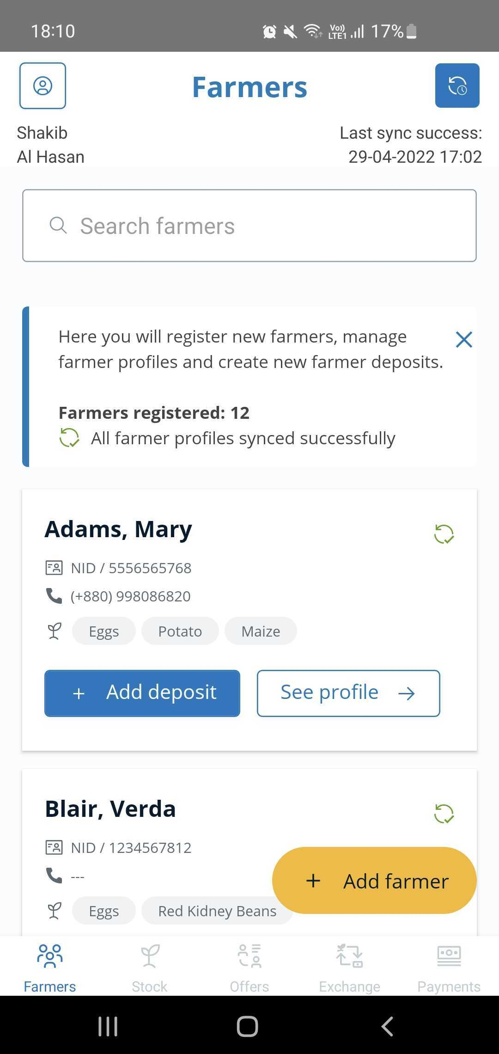
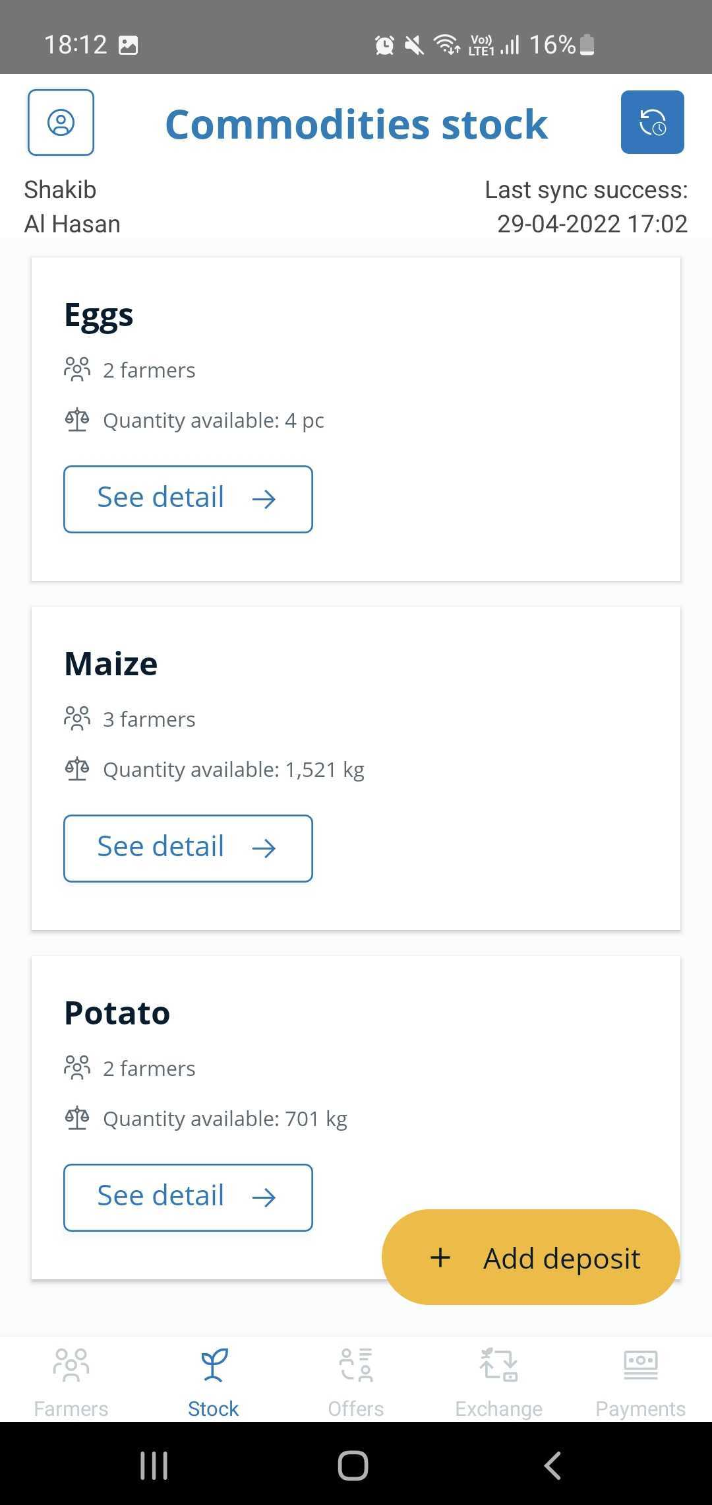
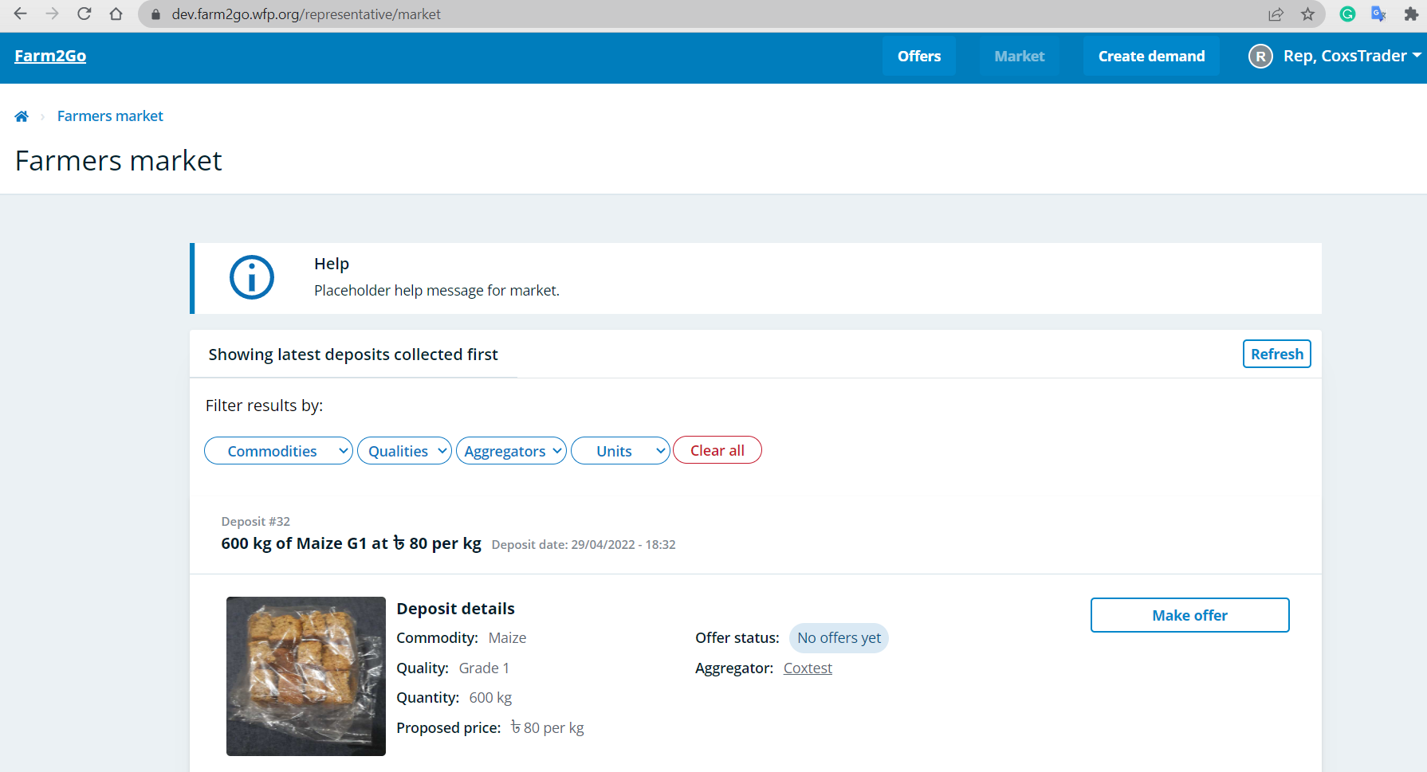
3.4 CONDUCIVE ENABLING ENVIRONMENTS: DIGITAL MARKET ACCESS
Farm2go Android mobile app for Aggregators
(also works offline)
Web application for Traders
(access from any device)
Notes:
Description​
Farm2Go is a digital solution developed internally by WFP’s Digital Transformation Unit (TEC-DTU) and Smallholder Agricultural Market Support (PRORF – SAMS) teams. The modules available in the digital solution are based on WFP requirements and the implementation relies on WFP smallholder farmer and/or retail linkage programme activities to be active in a Country Office. ​
​
Value proposition​
- Digitizing operations: Creating visibility on farmer activities at an Aggregation Center (Cooperative/Farmer Organization).​
- Market linkage: Connect farmers to buyers they didn’t have access to before.​
- Traceability: Understand the origin of commodities and promote a fair price to the farmer.​
- Improve monitoring: Indicator reporting on WFP’s Smallholder Agricultural Market Support activities in a country.​
​
Live implementations by WFP Country Offices​
- Rwanda since March 2022​
- Mozambique since April 2022​
- Bangladesh, Cox’s Bazar from May 2022​
- Philippines proposal submitted for July 2022

Slide 12



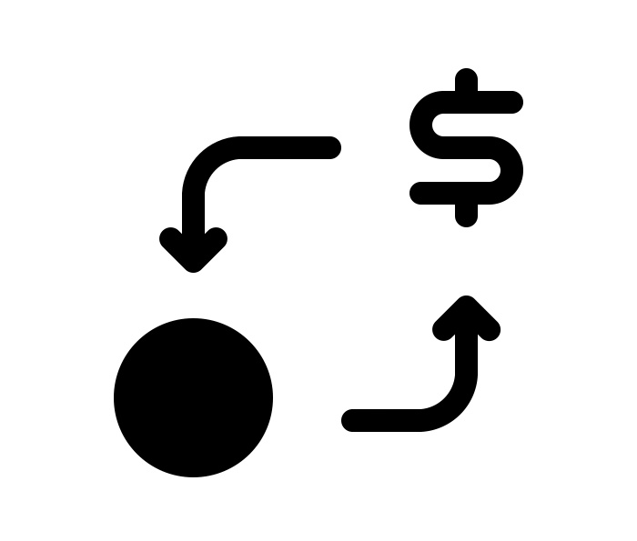



3.4 CONDUCIVE ENVIRONMENT: THE FARM 2 GO MODEL
WFP CO Managers
Creates
Traders
Aggregators
Commodities
Data available to WFP for reporting and to provide support with operational decision-making
Aggregator registers farmers and their commodities
Aggregator collects farmer commodities and registers quantity and price
Trader sends offer to buy commodities from Aggregator
Aggregator and Trader meet to exchange commodities for payment
Aggregator records payment to farmers for their deposits
Negotiation
Farmers
Stock
Offers
Exchange
Payments

Slide 13
3.4 CONDUCIVE ENVIRONMENT: THE MAANO VIRTUAL FARMERS MARKET
OFFTAKER VALUE PROPOSITION
PROBLEM STATEMENT
Price instability
Poor Audit trail
Low Transparency
Cash risk
Poor Access to market
Supply inconsistence
CONVENIENCE
Creating favorable business environment for off takers.
MARKET LINKAGES
Expanded market for off takers
SECURITY
Transaction trail in real time
Creating a one stop market for off takers
Track record of all aggregators for easy business options
Reduced cost of business (Cut off Syndicate)
Reduced lead time
Transparency and record of aggregators
Ease to use
Productivity maximization
Confidentiality of information
Ease of accessibility
Achieved economies of scale
SOLUTION
Digitalized trading platform (Ecommerce)
Real time transactions
Cashless transactions
Traceable audit trail
Accessibility
Market information
Notes:
In Zambia liaison with the Ministry of Agriculture, WFP also connects smallholder farmers to markets through
a network of aggregation centers and the digital mobile market platform ‘’Virtual Farmers’ Market’’, an
android app-based e-commerce platform where farmers and off-takers trade virtually. A three-tier private
sector-led aggregation model, which enhances the efficiency of commodity supply chains, is used. Key
actors in the model are: (i) off-takers/buyer/processors; (ii) intermediary aggregators; and (iii) microaggregators
(mostly lead farmers and community based agro-dealers). Aggregation centres play a critical
role in creating opportunities for stable household income, predictable markets, shared risks, access to
finance and inputs for smallholder farmers.

Slide 14


3.4 CONDUCIVE ENVIRONMENT: MAANO VIRTUAL FARMERS MARKET
Farmer Proposition
Easy access to premium markets.
Reduced transactional cost for farmers and buyers
Market Information and Price discovery
Better prices and higher incomes
Fair trade and negotiations
Increased production and business growth
Transparency

Slide 15
