Slide 1
Research on the Role and Contribution of Co-operatives Towards the South African Economic Reconstruction and Recovery Plan
Findings and Recommendations from the Research

Slide 2
Agenda
Project Objectives
Research Findings
Recommendations

Slide 3
Project Objectives

Slide 4
Project Objectives
To understand the role and contribution of co-operatives towards South Africa’s economic reform and recovery during the COVID-19 period
To explore the main impediments faced by co-operatives in competing in the South African economy at legislative, policy and strategic approach levels during COVID-19 and during lockdown regulations
To examine to what extent these impediments have affected the operations/livelihoods of co-operatives and their existence during the COVID-19 period
To identify mechanisms which may assist with strengthening the role of co-operatives as one of the main drivers of the economic recovery and reconstruction plan in South Africa
To document and share the lessons learned by co-operatives, private sector and government in responding to the COVID-19 pandemic
To understand the role of government and private sectors in supporting co-operatives towards restoring the economy
To provide recommendations from the research findings that can build a sustainable, resilient and inclusive economy

Slide 5
Research Findings

Slide 6
Role and Contribution of Co-operatives during COVID-19 period
“They can contribute much more if they can get grants from government.”
(Academia Interview, 2021)
“Most businesses we used to supply closed down during lockdown and didn’t open again, so we don’t have clientele anymore.”
(Co-operative Interview, 2021)
Key Findings
Challenges which impacted co-operatives contributions towards the economy included lack of a shared internal vision, loss of clients due to restrictions on movement and the inability to reach customers
It was noted that in order for co-operatives to contribute towards economic recovery and reform, government support will be key
Access to markets appears to be a challenge for some co-operatives. Some co-operatives were unable to sell their produce, while others were unable to meet the demands that come with access to new markets because they lack the necessary resources to produce on a larger scale.

Slide 7
Impact of COVID-19 on Co-operatives
Key Findings
Co-operatives appeared to have faced several challenges as a result of restrictions imposed by the COVID-19 National Lockdown. Some of these challenges included difficulties in supplying products to their customers, as well as a loss of customers during the National Lockdown, which subsequently led to a decrease in profits.

Slide 8
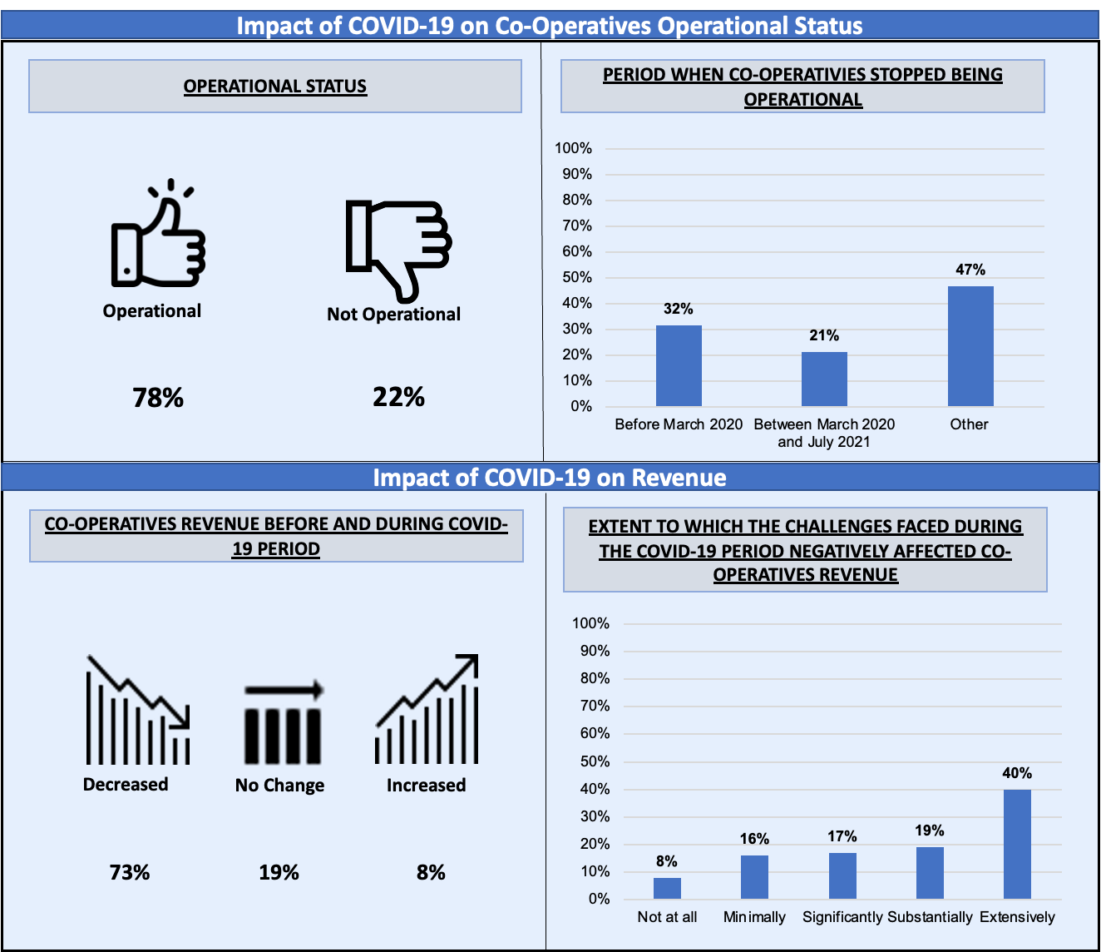
Impact of COVID-19 on Co-operative Operational Status and Revenue

Slide 9
Impact of COVID-19 on Operations
“Our operations were disturbed because our place of work had to be closed because of COVID-19. We saw that we had to pause operations because of regulations.”
(Co-operative Interview, 2021)
“During the COVID-19 [pandemic], we received grants and were able to keep operating.”
(Co-operative Interview, 2021)
Positive Practice
Some co-operatives received financial assistance in the form of grants during the COVID-19 pandemic and were therefore, able keep operating.
Key Findings
The majority of co-operatives appeared to have been impacted by the COVID-19 pandemic, having encountered issues such as loss of key members, halting operations due to lack of demand for their products, inability to travel to their customers due to restrictions on movement and a decrease in clientele, due to customers being afraid to travel to the co-operatives to buy products.
Co-operatives appear to have been facing challenges which impacted their operations prior to the COVID-19 pandemic.

Slide 10
Impact of COVID-19 on Quality of Services
“During COVID, not everyone in the farm was a skilled worker so it was tough. I had to go [and] get a certificate to upskill myself. We had to travel to go to the farm during the COVID-19 [pandemic], so it was a big problem for us since there were restrictions. And sometimes instead of ten employees coming to work, only two made it.”
(Co-operative Interview, 2021)
Key Findings
Restrictions on movement that were in place during the COVID-19 National Lockdown made it difficult for co-operative members to travel to work which resulted in shortages of skilled personnel.
Notes:
The majority of co-operatives believed that the quality of their services was negatively affected by COVID-19.

Slide 11
Impact of COVID-19 on Ability to Manage Business
“Because of stress and sickness, some people were not in the right mind to manage their businesses.”
(NPO Interview, 2021)
“Required licenses could not be accessed because most co-operatives had no access to information on where to get them.”
(NPO Interview, 2021)
Key Findings
Stakeholders highlighted that the lack of movement due to the COVID-19 lockdown travel restrictions made it difficult for co-operatives to run their businesses.
It was found that as a result of stress and poor health of individuals, some owners were unable to efficiently manage their businesses.

Slide 12
Challenges faced during COVID-19 pandemic
“We are suffering because there are no people on the street. A lot of people stay at home because of lockdown restrictions, so there is no one to sell our goods to. We only make money by selling baked goods and if there are no customers we suffer.”
(Co-operative Interview, 2021)
Key Findings
Some co-operatives stated that restrictions on movement impacted their ability to sell their products.
Challenges experienced by co-operatives included lack of resources, access to markets and loss of employees due to the inability to generate income.
Co-operatives in certain sectors, such as the sewing sector, may face the challenge of being unable to afford material for production post the COVID-19 period, given that their suppliers shut down during the COVID-19 period.

Slide 13
Adapting to Challenges Caused by COVID-19
Positive Practices
Some co-operatives were able to adapt to the challenges caused by the COVID-19 National Lockdown by producing and selling PPE items to their communities
Some co-operatives adopted certain measures, such as the pooling of financial resources and the use of digital platforms in their operations in order to be able to adapt to the challenges posed by the COVID-19 pandemic
Key Findings
Other co-operatives were unable to adapt to the challenges brought by the COVID-19 National Lockdown, and were, therefore, forced to close their business due to a lack of finances and a lack of knowledge regarding how to apply for financial assistance.

Slide 14
Co-operatives Contribution Towards Unemployment
“[Co-operatives] are able to create jobs and pay stipends to their workers. We need to create an environment where they will be able to upscale their activities and give them access to markets. They can play a big role [in reducing unemployment] if they are adequately supported by government.
(NDA Interview, 2021)
Positive Practices
The majority of stakeholders agreed that co-operatives could play a meaningful role in alleviating unemployment post COVID-19. Noting that co-operatives are the pillar of small and micro enterprises, which have a strong ability to create jobs. Co-operatives have a comparative advantage over other enterprises when it comes to job creation due to their labor-intensive nature which requires vast human resources.
Key Findings
There is a need for improvement regarding the management of co-operatives and the establishment of management structures. It was suggested that mentorship and entrepreneurial training be offered to co-operatives with financial management and administration skills.
Some respondents indicated that co-operatives contributed towards reducing unemployment before the COVID-19 pandemic and still continue to do so, however, challenges such as the loss of employees and income negatively affected the ability of co-operatives to create jobs.

Slide 15
Support Received During the COVID-19 Period
Key Findings
Several co-operatives did not receive any form of support from the government, private sector and the NDA during COVID-19, due to a lack of access to information; a lack of awareness regarding the types of support available and a lack of awareness regarding how to apply for the available support. Other barriers cited included the third-party costs associated with applying for support and compliance requirements not being met.

Slide 16
Impact of Support Received
Positive Practice
Several co-operatives were able to continue operating during the COVID-19 lockdown as a result of the support received from the government, private institutions and the NDA. The NDA should continue providing resources and other forms of support to co-operatives post COVID-19 to facilitate their contribution to economic recovery and reform.
Key Finding
Despite some co-operatives receiving support, it was not as effective due to the challenges that they continued to face as a result of the lockdown restrictions. It was found that some co-operatives lost customers and were unable to sell products, subsequently, these co-operatives could not keep operating. Certain stakeholders were also of the view that the lack of monitoring once support was allocated to co-operatives, resulted in a lack of accountability and the misuse of funds.

Slide 17
Role of Government, Private Sector and NDA
Key Findings
Some co-operatives stated that both financial and non-financial assistance would be required from government in order to address the challenges encountered.
It was found that government support may not be beneficial to some co-operatives, with some stakeholders highlighting that there appears to be a lack of collaboration, trust and a shared vision amongst co-operative members.
There appears to be a need for training aimed at upskilling co-operatives to allow them to contribute to the economy.
Ineffective implementation of the current legislation and policies appears to have prevented local government from providing support to co-operatives.

Slide 18
Positive Practices to Continue

Slide 19
Positive Practices
Focus Area
Positive Practice
Impact of COVID-19 on Operations of Co-operatives
Some co-operatives received financial assistance during the pandemic and were able to keep operating. Institutions should continue making efforts to provide financial assistance to co-operatives
Co-operatives’ Ability to Adapt to the Challenges Faced During the COVID-19 National Lockdown
Some co-operatives were able to adapt to the challenges caused by producing and selling PPE items.
Co-operatives adopted pooling of financial resources and the use of digital platforms & virtual approaches in their operations in order to adapt
Satisfaction with Support Received
Respondents who received support from the NDA and the government were satisfied with the support received. The NDA should continue providing resources and other forms of support to co-operatives post COVID-19
Impact of Support Received
Several co-operatives were able to continue operating during the lockdown as a result of the support received from government, private institutions and the NDA.
Role of Co-operatives in Reducing Unemployment Post COVID-19 Pandemic
Stakeholders agreed that co-operatives could play a meaningful role in alleviating unemployment post COVID-19 as they are considered to be the pillar of small and micro enterprises which have a strong ability to create jobs. This may also be due to their labour-intensive nature which requires vast human resources.

Slide 20
Recommendations

Slide 21
Key Findings and Recommendations
Key Theme
Recommendations
Lack of organisational structure, shared vision and access to information
Place emphasis on addressing issues which existed prior to the pandemic; provide increased conflict resolution training or career guidance counselling to co-operatives; provide information r.e. proper governance
Anticipated inability to afford material for production post the COVID-19 period.
Identify sectors most affected by the pandemic and facilitate the provision of support; link co-operatives to suppliers who are geographically closer; negotiate on behalf of co-operative for reduced rates; facilitate the development of partnerships between co-operatives to increase purchasing/bargaining power.
Lack of sustainability in the support provided to co-operatives
Develop a database for co-operatives who have received support to enable the tracking of support provided; ask for feedback on support provided; conduct a tracer study to understand the impact of the support provided
Ineffective implementation of legislation and policies preventing local government from providing support
Increase engagements with local government officials; ensure policies have clear and achievable milestones and are cognisant of the different types of co-operatives; develop a policy that focuses on the empowerment of women within co-operatives.
Lack of Funding Opportunities & Support From Government, Private Sector & the NDA
Inform co-operatives of the various forms of support available to their businesses (incl. application processes and compliance requirements); provide capacity building and mentoring to co-operatives
Lack of Monitoring after Support is allocated
Ensure thorough monitoring processes are in place to measure impact of the support
Challenges impacting co-operative's ability to create jobs
Ensure co-operatives are aware of forms of funding available; develop a co-operative specific support plan to provide training to address issues

Slide 22
Key Findings and Recommendations
Key Theme
Recommendations
Access to Markets/ Restrictions on Movement
Equip co-operatives with remote working skills and adequate digital tools; provide avenues for co-operatives to address skills shortages internally (e.g., registering with SETAs); conduct a study to determine potential opportunities available in a geographical location; provide relief support; provide special permits to co-operatives
Lack of Skills
Place emphasis on business and financial management training, mentorships and capacity building initiatives; provide ICT skills training workshops
Lack of Access to Internet and/or Technology
Facilitate access to information for co-operatives in rural areas; partner with internet service providers; provide support such as subsidies to co-ops who cannot operate remotely
Barriers to Co-operative Expansion and Development
Link co-operatives with opportunities for growth; host seminars to discuss the critical success factors of business and entrepreneurship; improve collaboration between co-operatives across provinces; ensure that co-operatives are not affected by political circumstances

Slide 23
Thank you!

